Slide 1
Secure Image Steganography
A Project on Data Hiding Using LSB Technique
Presented By: Maddala Jhansi Sahithi
Student Name : Maddala Jhansi Sahithi
College Name & Department : Vignan’s Institute of Engineering for Women, Computer Science and Engineering (CSE)

Slide 2
OUTLINE
Problem Statement
Technology used
Wow factor
End users
Result
Conclusion
Git-hub Link
Future scope

Slide 3
Problem Statement
With increasing digital communication, data security and privacy have become major concerns. Traditional encryption methods are often detectable, making them susceptible to attacks. Steganography provides an alternative way to secure sensitive information by hiding it within digital media, ensuring both confidentiality and undetectability.
This project aims to:
Embed secret messages inside images without altering their visual appearance.
Provide secure encryption for messages using a user-defined key.
Enable easy extraction of hidden messages with the correct decryption key.

Slide 4
Technology used
Programming Language: Python
Frameworks & Libraries: Flask, OpenCV, NumPy, Pillow (PIL), Cryptography (Fernet AES)
Tools: VS Code, Postman, GitHub
Hosting: Localhost (Flask backend & HTML frontend)
Platforms: Secure communication in messaging apps, confidential data transfer in corporate environments, and secure document sharing in government and defense sectors.

Slide 5
Wow factors
Invisible Yet Secure – The hidden message is seamlessly embedded into an image without altering its visual appearance, making it undetectable to the human eye.
Dual Functionality – Supports both encoding (hiding text inside images) and decoding (extracting hidden messages), ensuring a complete steganography solution.
User-Friendly Interface – Built with HTML, CSS, and JavaScript, providing an interactive and easy-to-use frontend for a smooth user experience.
Future Scalability – Can be extended to support audio and video steganography, enhancing security for multimedia data transmission.
Cross-Platform Compatibility – Works on Windows, macOS, and Linux, making it accessible across different environments.

Slide 6
End users
Businesses – Securely transmit confidential information.
Cybersecurity Professionals – Implement advanced steganographic techniques.
Journalists & Activists – Hide sensitive data in images for secure communication.
Developers & Researchers – Explore the potential of LSB-based steganography.
Educators & Students – Learn and experiment with steganography concepts for academic and research purposes.
Law Enforcement & Intelligence Agencies – Safeguard sensitive information and conduct secure covert communication.

Slide 7
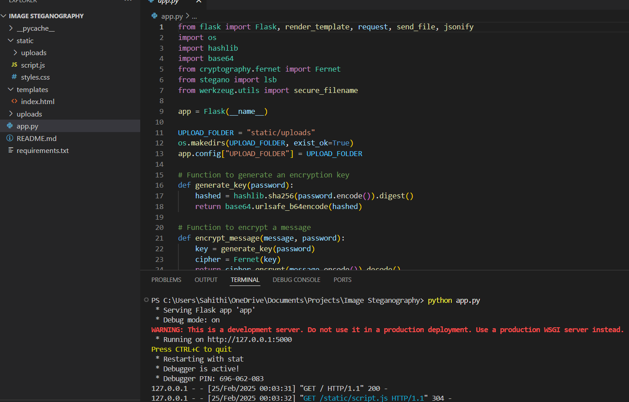
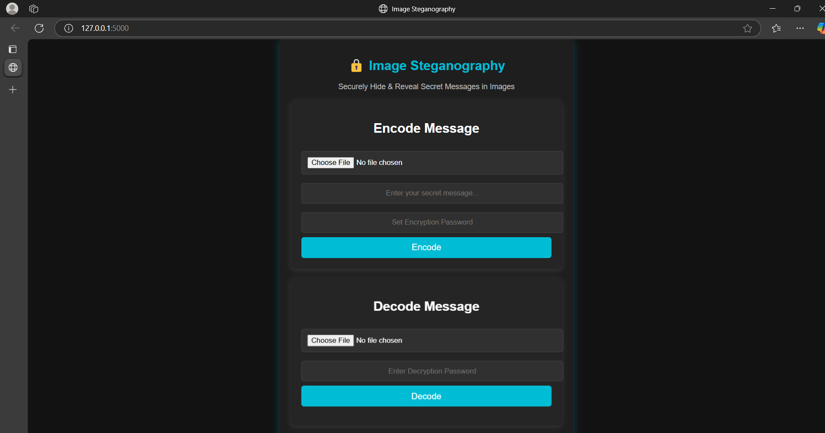
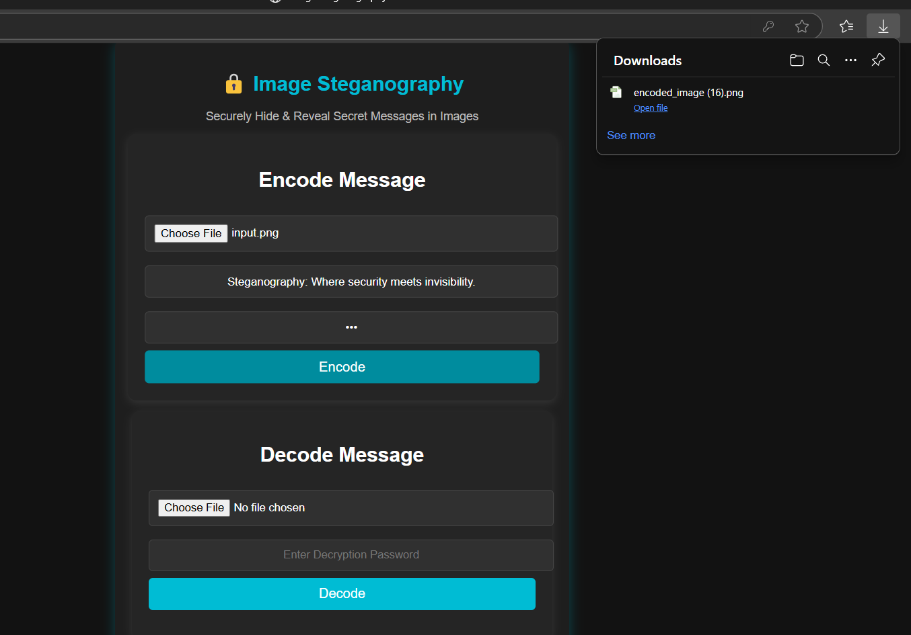
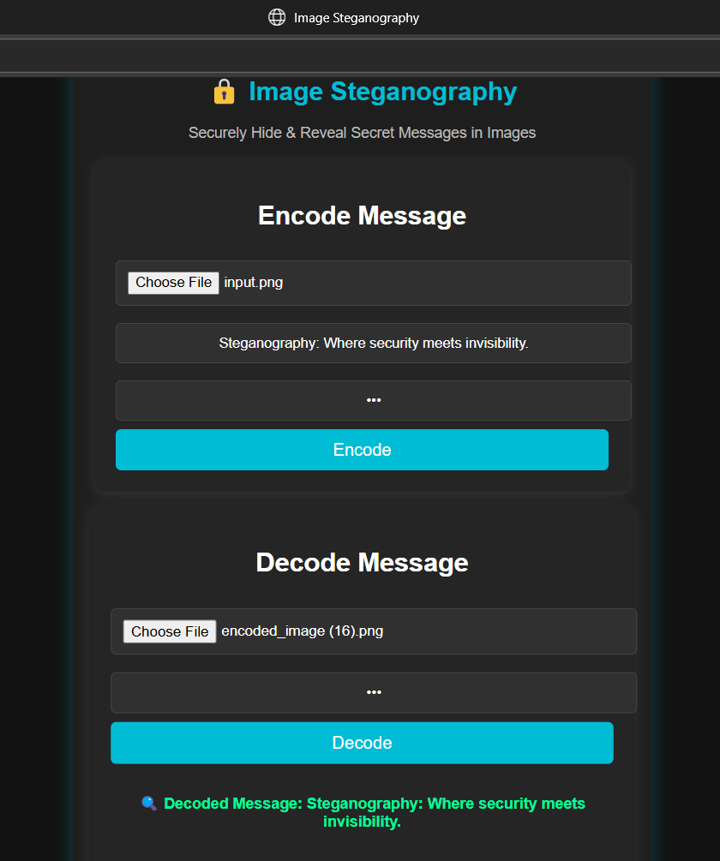
Results

Slide 8
Conclusion
This project demonstrates how image steganography using LSB can enhance data security and privacy. By leveraging encryption, metadata storage, and an intuitive interface, users can securely hide and retrieve sensitive information.

Slide 9
GitHub Link
https://github.com/Sahithi-Maddala/Image-Steganography

Slide 10
Future scope(optional)
Support for multiple image formats & higher resolutions
Extend steganography to video files
Incorporate advanced encryption for added security
Develop a web-based or mobile application

Slide 11
THANK YOU

